Slide 1
B8IT143
Operating Systems and Networks
Obinna Izima

Slide 2
My Details
Name: Obinna Izima
Email: Obinna.Izima@dbs.ie
Any questions, Please email me.

Slide 3
Learning Outcomes
1. Describe the architecture and organization of a computer system.
2. Explain operating systems concepts such as process, memory, file and device management.
3. Demonstrate practical skills in graphical and command line operation of Windows and Linux.
4. Illustrate mechanisms of data communications and typical network architectures/topologies.

Slide 4
Course Details
Days: Thursday 6.15pm – 9.30pm
Saturday March 27, 2021 (10:00 – 17:00)
CA - 50%
End of Semester Final Exam - 50%

Slide 5
Computer Architecture: Basic Concepts
Obinna Izima

Slide 6
Computer Architecture
Computer Organization
Computer Architecture
Attributes of a system visible to the programmer
Have a direct impact on the logical execution of a program
Architectural attributes include:
Instruction set, number of bits used to represent various data types, I/O mechanisms, techniques for addressing memory
Computer Organization
The operational units and their interconnections that realize the architectural specifications
Organizational attributes include:
Hardware details transparent to the programmer, control signals, interfaces between the computer and peripherals, memory technology used
Notes:
In describing computers, a distinction is often made between computer architecture
and computer organization. Although it is difficult to give precise definitions
for these terms, a consensus exists about the general areas covered by each
(e.g., see [VRAN80], [SIEW82], and [BELL78a]); an interesting alternative view
is presented in [REDD76].
Computer architecture refers to those attributes of a system visible to a
programmer or, put another way, those attributes that have a direct impact on
the logical execution of a program. A term that is often used interchangeably with computer
architecture is instruction set architecture (ISA) . The ISA defines instruction
formats, instruction opcodes, registers, instruction and data memory; the effect of
executed instructions on the registers and memory; and an algorithm for controlling
instruction execution.
Computer organization refers to the operational
units and their interconnections that realize the architectural specifications.
Examples of architectural attributes include the instruction set, the number of bits
used to represent various data types (e.g., numbers, characters), I/O mechanisms,
and techniques for addressing memory. Organizational attributes include those
hardware details transparent to the programmer, such as control signals; interfaces
between the computer and peripherals; and the memory technology used.
For example, it is an architectural design issue whether a computer will have
a multiply instruction. It is an organizational issue whether that instruction will
be implemented by a special multiply unit or by a mechanism that makes repeated
use of the add unit of the system. The organizational decision may be based on the
anticipated frequency of use of the multiply instruction, the relative speed of the two
approaches, and the cost and physical size of a special multiply unit.
Historically, and still today, the distinction between architecture and organization
has been an important one. Many computer manufacturers offer a family of
computer models, all with the same architecture but with differences in organization.
Consequently, the different models in the family have different price and performance
characteristics. Furthermore, a particular architecture may span many years and
encompass a number of different computer models, its organization changing with
changing technology.

Slide 7
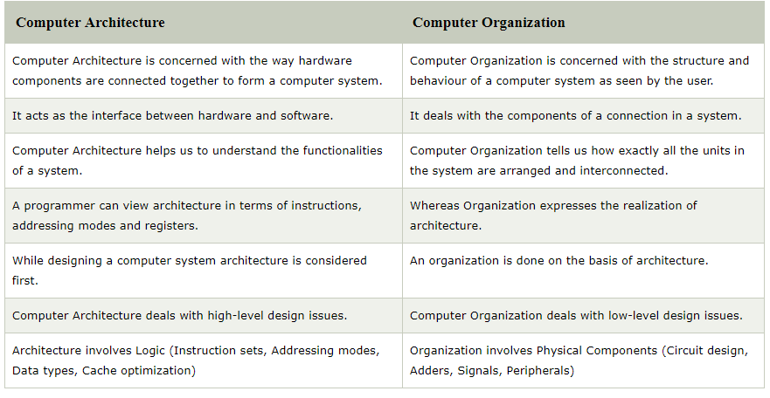
Computer Organization vs Architecture - 1

Slide 8
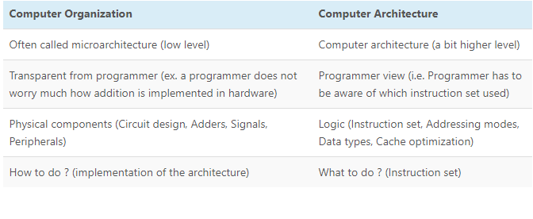
Computer Organization vs Architecture - 2
Notes:
https://www.8bitavenue.com/difference-between-computer-architecture-and-computer-organization/

Slide 9
Structure and Function
Hierarchical system
Set of interrelated subsystems
Hierarchical nature of complex systems is essential to both their design and their description
Designer need only deal with a particular level of the system at a time
Concerned with structure and function at each level
Structure
The way in which components relate to each other
Function
The operation of individual components as part of the structure
Notes:
A computer is a complex system; contemporary computers contain millions of
Elementary electronic components. How, then, can one clearly describe them?
The key is to recognize the hierarchical nature of most complex systems, including
the computer [SIMO96]. A hierarchical system is a set of interrelated subsystems,
each of the latter, in turn, hierarchical in structure until we reach some lowest level
of elementary subsystem.
The hierarchical nature of complex systems is essential to both their design
and their description. The designer need only deal with a particular level of the
system at a time. At each level, the system consists of a set of components and
their interrelationships. The behavior at each level depends only on a simplified,
abstracted characterization of the system at the next lower level. At each level, the
designer is concerned with structure and function:
• Structure: The way in which the components are interrelated.
• Function: The operation of each individual component as part of the structure.
In terms of description, we have two choices: starting at the bottom and building
up to a complete description, or beginning with a top view and decomposing the
system into its subparts. Evidence from a number of fields suggests that the top-down
approach is the clearest and most effective [WEIN75].
The approach taken in this book follows from this viewpoint. The computer
system will be described from the top down. We begin with the major components
of a computer, describing their structure and function, and proceed to successively
lower layers of the hierarchy. The remainder of this section provides a very brief
overview of this plan of attack.

Slide 10
Function
There are four basic functions that a computer can perform:
Data processing
Data may take a wide variety of forms and the range of processing requirements is broad
Data storage
Short-term
Long-term
Notes:
Both the structure and functioning of a computer are, in essence, simple. Figure 1.1
depicts the basic functions that a computer can perform. In general terms, there are
only four:
Data Processing. The data may take a wide
variety of forms, and the range of processing requirements is broad. However, we
shall see that there are only a few fundamental methods or types of data processing.
Data Storage. Even if the computer is processing
data on the fly (i.e., data come in and get processed, and the results go out
immediately), the computer must temporarily store at least those pieces of data
that are being worked on at any given moment. Thus, there is at least a short-term
data storage function. Equally important, the computer performs a long-term data
storage function. Files of data are stored on the computer for subsequent retrieval
and update.

Slide 11
Function
Data movement
Input-output (I/O) - when data are received from or delivered to a device (peripheral) that is directly connected to the computer
Data communications – when data are moved over longer distances, to or from a remote device
Control
A control unit manages the computer’s resources and organise the performance of its functional parts in response to instructions
Notes:
Data Movement. The computer’s operating environment consists of devices that serve as
either sources or destinations of data. When data are received from or delivered to
a device that is directly connected to the computer, the process is known as input–
output (I/O), and the device is referred to as a peripheral. When data are moved
over longer distances, to or from a remote device, the process is known as data
communications.
Control. Within the computer, a control unit manages the computer’s resources and orchestrates the
performance of its functional parts in response to those instructions.

Slide 12
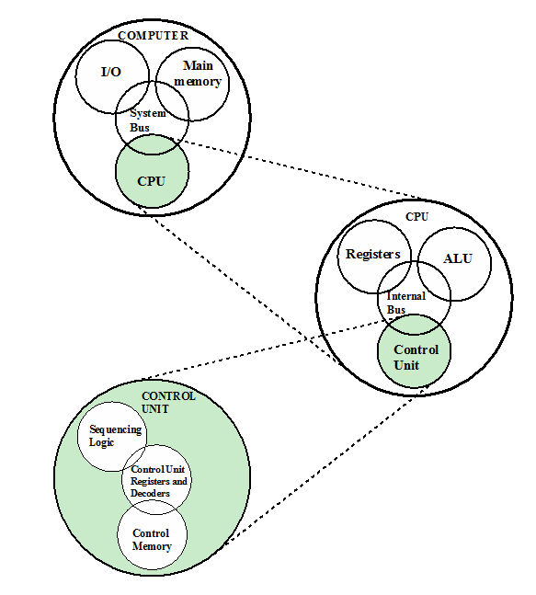
Structure
Notes:
We now look in a general way at the internal structure of a computer. We begin with
a traditional computer with a single processor that employs a microprogrammed
control unit, then examine a typical multicore structure.
Figure 1.1 provides a hierarchical view
of the internal structure of a traditional single-processor computer.

Slide 13
Function
CPU – controls the operation of the computer and performs its data processing functions
Main Memory – stores data
I/O – moves data between the computer and its external environment
System Interconnection – some mechanism that provides for communication among CPU, main memory, and I/O
Notes:
There are four main structural components:
• Central processing unit (CPU): Controls the operation of the computer and
performs its data processing functions; often simply referred to as processor.
• Main memory: Stores data.
• I/O: Moves data between the computer and its external environment.
• System interconnection: Some mechanism that provides for communication
among CPU, main memory, and I/O. A common example of system interconnection
is by means of a system bus, consisting of a number of conducting
wires to which all the other components attach.

Slide 14
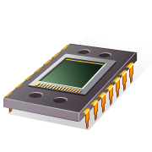
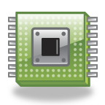
CPU
Control Unit
Controls the operation of the CPU and hence the computer
Arithmetic and Logic Unit (ALU)
Performs the computer’s data processing function
Registers
Provide storage internal to the CPU
CPU Interconnection
Some mechanism that provides for communication among the control unit, ALU, and registers
Major structural components:
Notes:
There may be one or more of each of the aforementioned components.
Traditionally, there has been just a single processor. In recent years, there has been
increasing use of multiple processors in a single computer. Some design issues relating
to multiple processors crop up and are discussed as the text proceeds; Part Five
focuses on such computers.
Each of these components will be examined in some detail in Part Two.
However, for our purposes, the most interesting and in some ways the most complex
component is the CPU. Its major structural components are as follows:
• Control unit: Controls the operation of the CPU and hence the computer.
• Arithmetic and logic unit (ALU): Performs the computer’s data processing
functions.
• Registers: Provides storage internal to the CPU.
• CPU interconnection: Some mechanism that provides for communication
among the control unit, ALU, and registers.
Part Three covers these components, where we will see that complexity is added by
the use of parallel and pipelined organizational techniques. Finally, there are several
approaches to the implementation of the control unit; one common approach is
a microprogrammed implementation. In essence, a microprogrammed control unit
operates by executing microinstructions that define the functionality of the control
unit. With this approach, the structure of the control unit can be depicted, as in
Figure 1.1. This structure is examined in Part Four.

Slide 15
Multicore Computer Structure
Central processing unit (CPU)
Portion of the computer that fetches and executes instructions
Consists of an ALU, a control unit, and registers (interconnection)
Referred to as a processor in a system with a single processing unit
Notes:
As was mentioned, contemporary
computers generally have multiple processors. When these processors all reside
on a single chip, the term multicore computer is used, and each processing unit
(consisting of a control unit, ALU, registers, and perhaps cache) is called a core . To
clarify the terminology, this text will use the following definitions.
■ Central processing unit (CPU) : That portion of a computer that fetches and
executes instructions. It consists of an ALU, a control unit, and registers. In a
system with a single processing unit, it is often simply referred to as a processor .
■ Core : An individual processing unit on a processor chip. A core may be
equivalent in functionality to a CPU on a single-CPU system. Other specialized processing units,
such as one optimized for vector and matrix operations, are also referred to as cores.
■ Processor: A physical piece of silicon containing one or more cores. The
processor is the computer component that interprets and executes instructions.
If a processor contains multiple cores, it is referred to as a multicore
processor .
After about a decade of discussion, there is broad industry consensus on this
usage.

Slide 16
Multicore Computer Structure
Core
An individual processing unit on a processor chip
May be equivalent in functionality to a CPU on a single-CPU system
Specialized processing units are also referred to as cores
Processor
A physical piece of silicon containing one or more cores
Is the computer component that interprets and executes instructions
Referred to as a multicore processor if it contains multiple cores
Notes:
A core is the most basic computational/processing unit of a CPU capable of executing one instruction at a time. It consists of its own Arithmetic Logic Unit, Control Unit and set of registers. Where early CPUs consisted of only a single core, current CPUs can have several cores. You should note that the CPU itself remains a single physical computational unit which rather multiple cores.
Multi-core processors can be dual-core (2 CPUs), quad-core (4 CPUs) and so on and so forth and these execute parallel instructions at the same time given that each core is its own CPU. Hyperthreading further doubles the number of CPUs (called logical processors this time) for PCs that support it.
a CPU performs basic arithmetic, logical, control and input/output operations. The core for its part does the actual legwork here, which includes fetch, decode and execute.

Slide 17
Cache Memory
The data or contents of the main memory that are used frequently by CPU are stored in the cache memory so that the processor can easily access that data in a shorter time.
Whenever the CPU requires accessing memory, it first checks the required data into the cache memory. If the data is found in the cache memory, it is read from the fast memory.
Otherwise, the CPU moves onto the main memory for the required data.
Is smaller and faster than main memory
Used to speed up memory access by placing in the cache data from main memory that is likely to be used in the near future
Notes:
Cache memory
Multiple layers of memory between the processor and main memory

Slide 18
Cache Memory -contd
Small and very fast temporary storage memory
Designed to speed up the transfer of data and instructions
Located inside or close to the CPU chip
Faster than the RAM and houses data/instructions that are most recently or most frequently used by the CPU
Notes:
The data and instructions are retrieved from RAM when CPU uses them for the first time. A copy of that data or instructions is stored in cache. The next time the CPU needs that data or instructions, it first looks in cache. If the required data is found there, it is retrieved from cache memory instead of main memory. It speeds up the working of CPU.

Slide 19
Types/Levels of Cache Memory
Level 1 (L1) Cache
It is also called primary or internal cache. It is built directly into the processor chip. It has small capacity from 2 kb to 64 Kb.
Level 2 (L2) Cache
It is slower than L1 cache. Its storage capacity is more, i-e. From 64 Kb to 2 MB. The current processors contain advanced transfer cache on processor chip that is a type of L2 cache. The common size of this cache is from 512 kb to 8 Mb.
Level 3 (L3) Cache
This cache is separate from processor chip on the motherboard. It exists on the computer that uses L2 advanced transfer cache. It is slower than L1 and L2 cache. The personal computer often has up to 8 MB of L3 cache.
Notes:
A computer can have several different levels of cache memory. The level numbers refers to distance from CPU where Level 1 is the closest.
All levels of cache memory are faster than RAM. The cache closest to CPU is always faster but generally costs more and stores less data then other level of cache.
________________________
In order for the core to be more efficient doing its job for FEDEX, it has two means of transport AKA cache. L1 cache is akin to a bicycle which is fastest and weaves through the road network like a bread through butter. L1 cache is the closest and smallest but also the fasted. L2 cache is a delivery van which is bigger but not as fast as L1 cache. L1 and L2 cache serve the purpose of storing data to and from RAM to speed up access.
____________________
https://byte-notes.com/what-cache-memory/
https://specialties.bayt.com/en/specialties/q/305444/what-is-the-difference-between-l1-l2-and-l3-cache-memory/

Slide 20
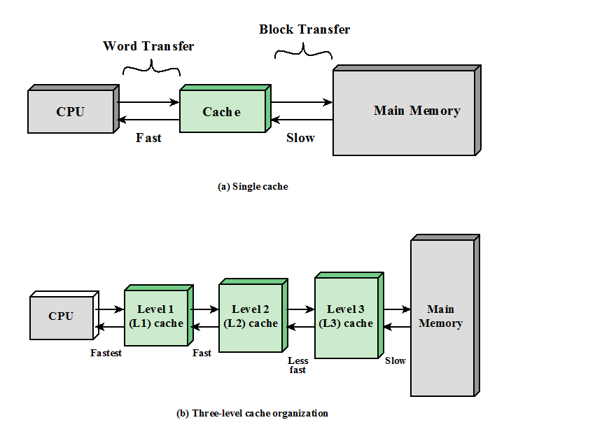
Notes:
Cache memory is designed to combine the memory access time of expensive, high-speed
memory combined with the large memory size of less expensive, lower-speed
memory.
The concept is illustrated in Figure 4.3a. There is a relatively large and slow
main memory together with a smaller, faster cache memory. The cache contains a
copy of portions of main memory. When the processor attempts to read a word of
memory, a check is made to determine if the word is in the cache. If so, the word is
delivered to the processor. If not, a block of main memory, consisting of some fixed
number of words, is read into the cache and then the word is delivered to the processor.
Because of the phenomenon of locality of reference, when a block of data is
fetched into the cache to satisfy a single memory reference, it is likely that there will
be future references to that same memory location or to other words in the block.
Figure 4.3b depicts the use of multiple levels of cache. The L2 cache is slower
and typically larger than the L1 cache, and the L3 cache is slower and typically
larger than the L2 cache.

Slide 21
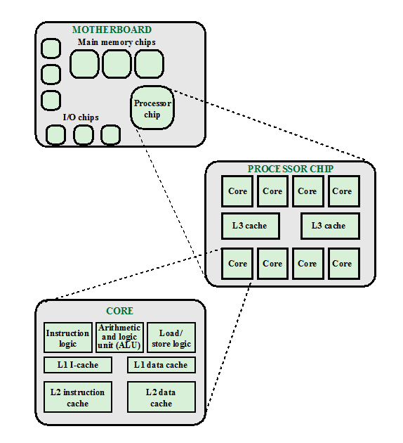
Simplified View of a multi-core computer
Notes:
Figure 1.2 is a simplified view of the principal components of a typical multicore
computer. Most computers, including embedded computers in smartphones
and tablets, plus personal computers, laptops, and workstations, are housed on a
motherboard. Before describing this arrangement, we need to define some terms.
A printed circuit board is a rigid, flat board that holds and interconnects chips and
other electronic components. The board is made of layers, typically two to ten,
that interconnect components via copper pathways that are etched into the board.
The main printed circuit board (PCB) in a computer is called a system board or
motherboard , while smaller ones that plug into the slots in the main board are
called expansion boards.
The most prominent elements on the motherboard are the chips. A chip is
a single piece of semiconducting material, typically silicon, upon which electronic
circuits and logic gates are fabricated. The resulting product is referred to as an
integrated circuit .
The motherboard contains a slot or socket for the processor chip, which typically
contains multiple individual cores, in what is known as a multicore processor .
There are also slots for memory chips, I/O controller chips, and other key computer
components. For desktop computers, expansion slots enable the inclusion of more
components on expansion boards. Thus, a modern motherboard connects only a
few individual chip components, with each chip containing from a few thousand up
to hundreds of millions of transistors.
Figure 1.2 shows a processor chip that contains eight cores and an L3 cache.
Not shown is the logic required to control operations between the cores and the
cache and between the cores and the external circuitry on the motherboard. The
figure indicates that the L3 cache occupies two distinct portions of the chip surface.
However, typically, all cores have access to the entire L3 cache via the aforementioned
control circuits. The processor chip shown in Figure 1.2 does not represent
any specific product, but provides a general idea of how such chips are laid out.
Next, we zoom in on the structure of a single core, which occupies a portion of
the processor chip. In general terms, the functional elements of a core are:
■ Instruction logic: This includes the tasks involved in fetching instructions and
decoding each instruction to determine the instruction operation and the
memory locations of any operands.
■ Arithmetic and logic unit (ALU): Performs the operation specified by an
instruction.
■ Load/store logic: Manages the transfer of data to and from main memory via
cache.
The core also contains an L1 cache, split between an instruction cache
(I-cache) that is used for the transfer of instructions to and from main memory, and
an L1 data cache, for the transfer of operands and results. Typically, today’s processor
chips also include an L2 cache as part of the core. In many cases, this cache
is also split between instruction and data caches, although a combined, single L2
cache is also used.
Keep in mind that this representation of the layout of the core is only intended
to give a general idea of internal core structure. In a given product, the functional
elements may not be laid out as the three distinct elements shown in Figure 1.2,
especially if some or all of these functions are implemented as part of a microprogrammed
control unit.

Slide 22
Processor
Two internal registers
Memory address register (MAR)
Specifies the address for the next read or write
Memory buffer register (MBR)
Contains data written into memory or receives data read from memory
I/O address register
I/O buffer register
Notes:
Registers. These are memory cells built right into the CPU that contain specific data needed by the CPU, particularly the arithmetic and logic unit (ALU). An integral part of the CPU itself, they are controlled directly by the compiler that sends information for the CPU to process.

Slide 23
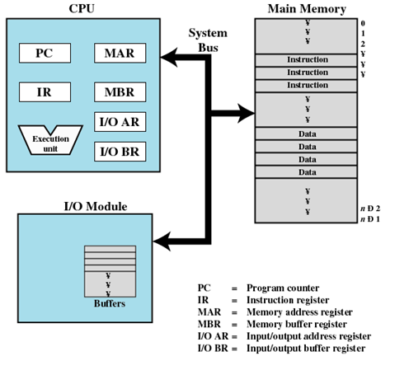
Top-Level Components
Notes:
This figure illustrates the top-level components of a computer system and the interactions among them.
The CPU exchanges data with memory—to accomplish this it requires two internal registers(they are internal to the CPU): MAR – which specifies the address in memory for the next read or write and a MBR – contains data to be written into memory or receives the data read from memory.
I/O address register(I/OAR) specifies a particular I/O device.
I/O buffer register(I/OBR) is used for data exchange between an I/O module and the CPU.
Memory module—set of locations defined by sequentially numbered addresses. Each location contains a binary number that can be interpreted as either an instruction or data.
I/O module transfer data from external devices to CPU and memory, and vice versa. It contains internal buffers for temporary storage of data.

Slide 24
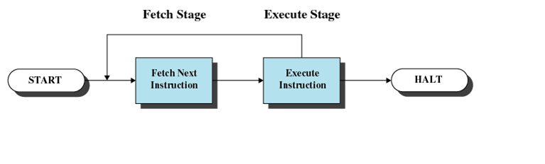
Instruction Cycle

Slide 25
Fetch Cycle
At the beginning of each instruction cycle the processor fetches an instruction from memory
The program counter (PC) holds the address of the instruction to be fetched next
The processor increments the PC after each instruction fetch so that it will fetch the next instruction in sequence
The fetched instruction is loaded into the instruction register (IR)
The processor interprets the instruction and performs the required action
Notes:
At the beginning of each instruction cycle, the processor fetches an instruction
from memory. In a typical processor, a register called the program counter (PC)
holds the address of the instruction to be fetched next. Unless told otherwise, the
processor always increments the PC after each instruction fetch so that it will fetch
the next instruction in sequence (i.e., the instruction located at the next higher memory
address). So, for example, consider a computer in which each instruction occupies
one 16-bit word of memory. Assume that the program counter is set to memory
location 300, where the location address refers to a 16-bit word. The processor will
next fetch the instruction at location 300. On succeeding instruction cycles, it will
fetch instructions from locations 301, 302, 303, and so on. This sequence may be
altered, as explained presently.
The fetched instruction is loaded into a register in the processor known as
the instruction register (IR). The instruction contains bits that specify the action
the processor is to take. The processor interprets the instruction and performs the
required action.

Slide 26
Instruction Fetch and Execute
The processor fetches the instruction from memory
Program counter (PC) holds address of the instruction to be fetched next
Program counter is incremented after each fetch

Slide 27
Instruction Register
Fetched instruction is placed in the instruction register
Categories
Processor-memory
Transfer data between processor and memory
Processor-I/O
Data transferred to or from a peripheral device
Data processing
Arithmetic or logic operation on data
Control
Alter sequence of execution

Slide 28
Action Categories
Processor-memory
Data transferred from processor to memory or from memory to processor
Processor-I/O
Data transferred to or from a peripheral device by transferring between the processor and an I/O module
Data processing
The processor may perform some arithmetic or logic operation on data
Control
An instruction may specify that the sequence of execution be altered
Notes:
In general, these actions fall into four categories:
Processor-memory: Data may be transferred from processor to memory or
from memory to processor.
• Processor-I/O: Data may be transferred to or from a peripheral device by
transferring between the processor and an I/O module.
• Data processing: The processor may perform some arithmetic or logic operation
on data.
• Control: An instruction may specify that the sequence of execution be altered.
For example, the processor may fetch an instruction from location 149, which
specifies that the next instruction be from location 182. The processor will
remember this fact by setting the program counter to 182. Thus, on the next
fetch cycle, the instruction will be fetched from location 182 rather than 150.
An instruction’s execution may involve a combination of these actions.

Slide 29
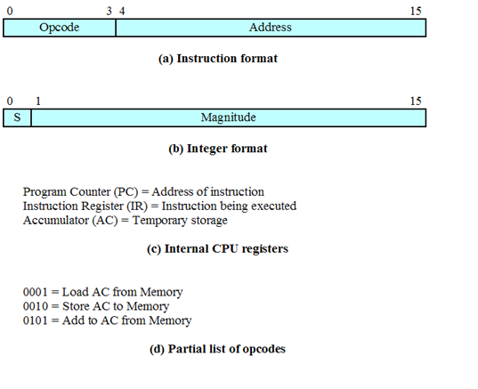
Characteristics of a Hypothetical Machine

Slide 30
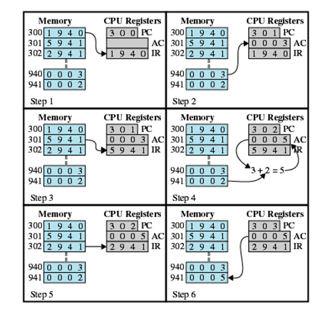
Example of Program Execution

Slide 31
Memory Systems
Location
Refers to whether memory is internal and external to the computer
Internal memory is often equated with main memory
Processor requires its own local memory, in the form of registers
Cache is another form of internal memory
External memory consists of peripheral storage devices that are accessible to the processor via I/O controllers
Notes:
The term location in Table 4.1 refers to whether memory is internal and external
to the computer. Internal memory is often equated with main memory. But there
are other forms of internal memory. The processor requires its own local memory, in
the form of registers (e.g., see Figure 2.3). Further, as we shall see, the control unit
portion of the processor may also require its own internal memory. We will defer
discussion of these latter two types of internal memory to later chapters. Cache is
another form of internal memory. External memory consists of peripheral storage
devices, such as disk and tape, that are accessible to the processor via I/O controllers.

Slide 32
Characteristics of Memory Systems
Capacity
Memory is typically expressed in terms of bytes (1 byte = 8 bits)
Unit of transfer
For internal memory the unit of transfer is equal to the number of electrical lines into and out of the memory module
Physical Characteristics: Volatile/non-volatile; erasable/nonerasable
Volatile(electricity dependent) – RAM
Non-volatile(information remains until deliberate change) ROM
Notes:
An obvious characteristic of memory is its capacity. For internal memory, this is
typically expressed in terms of bytes (1 byte = 8 bits) or words. Common word lengths
are 8, 16, and 32 bits. External memory capacity is typically expressed in terms of bytes.
A related concept is the unit of transfer. For internal memory, the unit
of transfer is equal to the number of electrical lines into and out of the memory
module. This may be equal to the word length, but is often larger, such as 64, 128, or
256 bits. To clarify this point, consider three related concepts for internal memory:
• Word: The “natural” unit of organization of memory. The size of a word is typically
equal to the number of bits used to represent an integer and to the instruction
length. Unfortunately, there are many exceptions. For example, the CRAY
C90 (an older model CRAY supercomputer) has a 64-bit word length but uses
a 46-bit integer representation. The Intel x86 architecture has a wide variety of
instruction lengths, expressed as multiples of bytes, and a word size of 32 bits.
• Addressable units: In some systems, the addressable unit is the word. However,
many systems allow addressing at the byte level. In any case, the relationship
between the length in bits A of an address and the number N of addressable
units is 2^{A} = N.
• Unit of transfer: For main memory, this is the number of bits read out of or
written into memory at a time. The unit of transfer need not equal a word or
an addressable unit. For external memory, data are often transferred in much
larger units than a word, and these are referred to as blocks

Slide 33
Characteristics of Memory Systems - 2
Bit size:The bit size of a CPU tells you how many bytes of information it can access from RAM at the same time. For example, a 16-bit CPU can process 2 bytes at a time (1 byte = 8 bits, so 16 bits = 2 bytes), and a 64-bit CPU can process 8 bytes at a time.
Speed
Megahertz (MHz) is a measure of a CPU's processing speed, or clock cycle, in millions per second. So, a 32-bit 800-MHz Pentium III can potentially process 4 bytes simultaneously, 800 million times per second (possibly more based on pipelining)! The goal of the memory system is to meet those requirements.
Notes:
An obvious characteristic of memory is its capacity. For internal memory, this is
typically expressed in terms of bytes (1 byte = 8 bits) or words. Common word lengths
are 8, 16, and 32 bits. External memory capacity is typically expressed in terms of bytes.
A related concept is the unit of transfer. For internal memory, the unit
of transfer is equal to the number of electrical lines into and out of the memory
module. This may be equal to the word length, but is often larger, such as 64, 128, or
256 bits. To clarify this point, consider three related concepts for internal memory:
• Word: The “natural” unit of organization of memory. The size of a word is typically
equal to the number of bits used to represent an integer and to the instruction
length. Unfortunately, there are many exceptions. For example, the CRAY
C90 (an older model CRAY supercomputer) has a 64-bit word length but uses
a 46-bit integer representation. The Intel x86 architecture has a wide variety of
instruction lengths, expressed as multiples of bytes, and a word size of 32 bits.
• Addressable units: In some systems, the addressable unit is the word. However,
many systems allow addressing at the byte level. In any case, the relationship
between the length in bits A of an address and the number N of addressable
units is 2^{A} = N.
• Unit of transfer: For main memory, this is the number of bits read out of or
written into memory at a time. The unit of transfer need not equal a word or
an addressable unit. For external memory, data are often transferred in much
larger units than a word, and these are referred to as blocks

Slide 34
Memory
The most common forms are:
Semiconductor memory
Magnetic surface memory
Optical
Magneto-optical
Notes:
A variety of physical types of memory have been employed. The most common
today are semiconductor memory, magnetic surface memory, used for disk and
tape, and optical and magneto-optical.
Several physical characteristics of data storage are important. In a volatile
memory, information decays naturally or is lost when electrical power is switched
off. In a nonvolatile memory, information once recorded remains without deterioration
until deliberately changed; no electrical power is needed to retain information.
Magnetic-surface memories are nonvolatile. Semiconductor memory (memory
on integrated circuits) may be either volatile or nonvolatile. Nonerasable memory
cannot be altered, except by destroying the storage unit. Semiconductor memory of
this type is known as read-only memory (ROM). Of necessity, a practical nonerasable
memory must also be nonvolatile.
For random-access memory, the organization is a key design issue. In this context,
organization refers to the physical arrangement of bits to form words. The
obvious arrangement is not always used, as is explained in Chapter 5.

Slide 35
Memory
Several physical characteristics of data storage are important:
Volatile memory
Information decays naturally or is lost when electrical power is switched off
Nonvolatile memory
Once recorded, information remains without deterioration until deliberately changed
No electrical power is needed to retain information
Magnetic-surface memories
Are nonvolatile
Semiconductor memory
May be either volatile or nonvolatile
Nonerasable memory
Cannot be altered, except by destroying the storage unit
Semiconductor memory of this type is known as read-only memory (ROM)

Slide 36
Memory Hierarchy
Design constraints on a computer’s memory can be summed up by three questions:
How much, how fast, how expensive
There is a trade-off among capacity, access time, and cost
Faster access time, greater cost per bit
Greater capacity, smaller cost per bit
Greater capacity, slower access time
The way out of the memory dilemma is not to rely on a single memory component or technology, but to employ a memory hierarchy
Notes:
The design constraints on a computer’s memory can be summed up by three questions:
How much? How fast? How expensive?
The question of how much is somewhat open ended. If the capacity is there,
applications will likely be developed to use it. The question of how fast is, in a sense,
easier to answer. To achieve greatest performance, the memory must be able to
keep up with the processor. That is, as the processor is executing instructions, we
would not want it to have to pause waiting for instructions or operands. The final
question must also be considered. For a practical system, the cost of memory must
be reasonable in relationship to other components.
As might be expected, there is a trade-off among the three key characteristics
of memory: capacity, access time, and cost. A variety of technologies are used to
implement memory systems, and across this spectrum of technologies, the following
relationships hold:
• Faster access time, greater cost per bit
• Greater capacity, smaller cost per bit
• Greater capacity, slower access time
The dilemma facing the designer is clear. The designer would like to use memory
technologies that provide for large-capacity memory, both because the capacity
is needed and because the cost per bit is low. However, to meet performance
requirements, the designer needs to use expensive, relatively lower-capacity memories
with short access times.
The way out of this dilemma is not to rely on a single memory component or
technology, but to employ a memory hierarchy.

Slide 37
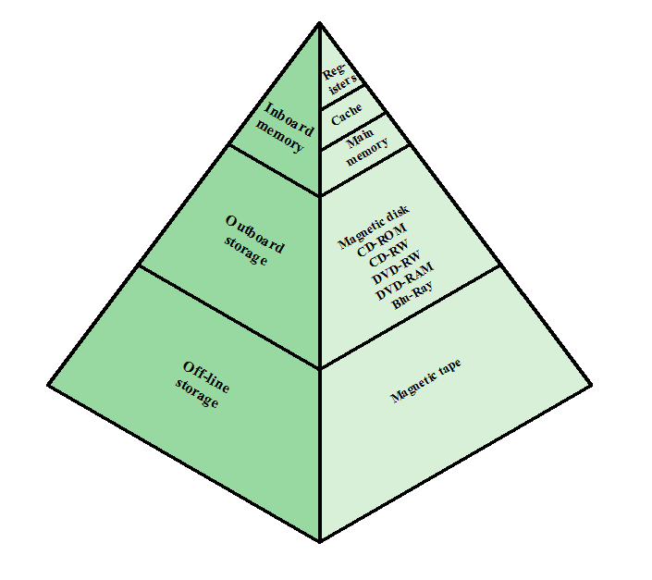
Notes:
A typical hierarchy is illustrated in
Figure 4.1. As one goes down the hierarchy, the following occur:
a. Decreasing cost per bit
b. Increasing capacity
c. Increasing access time
d. Decreasing frequency of access of the memory by the processor
Thus, smaller, more expensive, faster memories are supplemented by larger,
cheaper, slower memories. The key to the success of this organization is item (d)
:decreasing frequency of access. We examine this concept in greater detail when we
discuss the cache, later in this chapter, and virtual memory in Chapter 8. A brief
explanation is provided at this point.
The use of two levels of memory to reduce average access time works in principle,
but only if conditions (a) through (d) apply. By employing a variety of technologies,
a spectrum of memory systems exists that satisfies conditions (a) through
(c). Fortunately, condition (d) is also generally valid.
The basis for the validity of condition (d) is a principle known as locality of
reference [DENN68]. During the course of execution of a program, memory references
by the processor, for both instructions and data, tend to cluster. Programs
typically contain a number of iterative loops and subroutines. Once a loop or subroutine
is entered, there are repeated references to a small set of instructions.
Similarly, operations on tables and arrays involve access to a clustered set of data
words. Over a long period of time, the clusters in use change, but over a short period
of time, the processor is primarily working with fixed clusters of memory references.

Slide 38
Memory
The use of three levels exploits the fact that semiconductor memory comes in a variety of types which differ in speed and cost
Data are stored more permanently on external mass storage devices
External, nonvolatile memory is also referred to as secondary memory or auxiliary memory
Disk cache
A portion of main memory can be used as a buffer to hold data temporarily that is to be read out to disk
A few large transfers of data can be used instead of many small transfers of data
Data can be retrieved rapidly from the software cache rather than slowly from the disk
Notes:
The three forms of memory just described are, typically, volatile and employ
semiconductor technology. The use of three levels exploits the fact that semiconductor
memory comes in a variety of types, which differ in speed and cost. Data are
stored more permanently on external mass storage devices, of which the most common
are hard disk and removable media, such as removable magnetic disk, tape,
and optical storage. External, nonvolatile memory is also referred to as secondary
memory or auxiliary memory . These are used to store program and data files and
are usually visible to the programmer only in terms of files and records, as opposed
to individual bytes or words. Disk is also used to provide an extension to main memory
known as virtual memory, which is discussed in Chapter 8.
Other forms of memory may be included in the hierarchy. For example, large
IBM mainframes include a form of internal memory known as expanded storage.
This uses a semiconductor technology that is slower and less expensive than that
of main memory. Strictly speaking, this memory does not fit into the hierarchy but
is a side branch: Data can be moved between main memory and expanded storage
but not between expanded storage and external memory. Other forms of secondary
memory include optical and magneto-optical disks. Finally, additional levels can be
effectively added to the hierarchy in software. A portion of main memory can be
used as a buffer to hold data temporarily that is to be read out to disk. Such a technique,
sometimes referred to as a disk cache, improves performance in two ways:
■ Disk writes are clustered. Instead of many small transfers of data, we have
a few large transfers of data. This improves disk performance and minimizes
processor involvement.
■ Some data destined for write-out
may be referenced by a program before the
next dump to disk. In that case, the data are retrieved rapidly from the software
cache rather than slowly from the disk.
Appendix 4A examines the performance implications of multilevel memory
structures.

Slide 39
Notes:
Cache memory is designed to combine the memory access time of expensive, high-speed
memory combined with the large memory size of less expensive, lower-speed
memory.
The concept is illustrated in Figure 4.3a. There is a relatively large and slow
main memory together with a smaller, faster cache memory. The cache contains a
copy of portions of main memory. When the processor attempts to read a word of
memory, a check is made to determine if the word is in the cache. If so, the word is
delivered to the processor. If not, a block of main memory, consisting of some fixed
number of words, is read into the cache and then the word is delivered to the processor.
Because of the phenomenon of locality of reference, when a block of data is
fetched into the cache to satisfy a single memory reference, it is likely that there will
be future references to that same memory location or to other words in the block.
Figure 4.3b depicts the use of multiple levels of cache. The L2 cache is slower
and typically larger than the L1 cache, and the L3 cache is slower and typically
larger than the L2 cache.

Slide 40
Memory
RAM
ROM
Cache
Dynamic RAM
Static RAM
Flash memory
Virtual memory
Hard drive

Slide 41
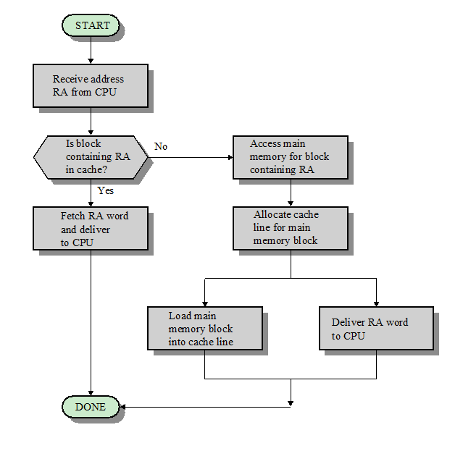
Notes:
Figure 4.5 illustrates the read operation. The processor generates the read
address (RA) of a word to be read. If the word is contained in the cache, it is delivered
to the processor. Otherwise, the block containing that word is loaded into the
cache, and the word is delivered to the processor.
Figure 4.5 shows these last two
operations occurring in parallel and reflects the organization shown in Figure 4.6,
which is typical of contemporary cache organizations.

Slide 42
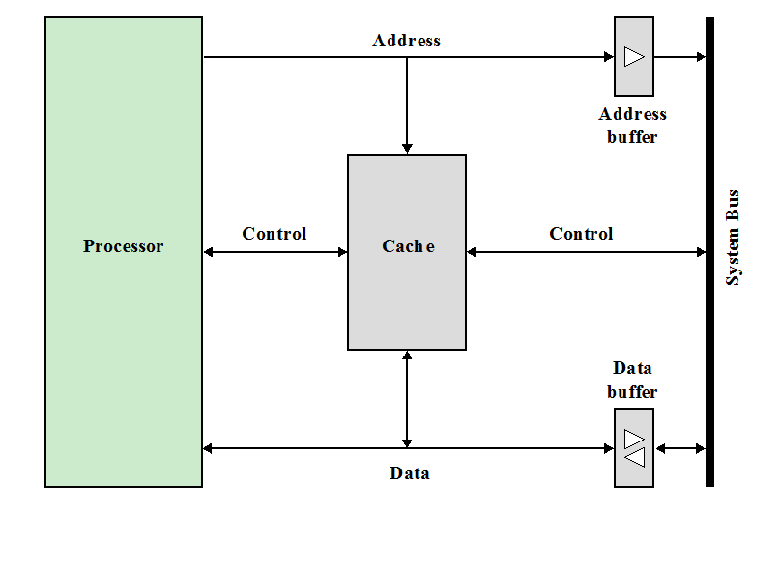
Notes:
In this organization, the cache
connects to the processor via data, control, and address lines. The data and address
lines also attach to data and address buffers, which attach to a system bus from
which main memory is reached. When a cache hit occurs, the data and address buffers
are disabled and communication is only between processor and cache, with no
system bus traffic. When a cache miss occurs, the desired address is loaded onto the
system bus and the data are returned through the data buffer to both the cache and
the processor. In other organizations, the cache is physically interposed between
the processor and the main memory for all data, address, and control lines. In this
latter case, for a cache miss, the desired word is first read into the cache and then
transferred from cache to processor.
A discussion of the performance parameters related to cache use is contained
in Appendix 4A.

Slide 43
Internal Memory
Semi-conductor memory Types
Random Access Memory (RAM)
Read Only Memory (ROM)
Programmable ROM (PROM)
Erasable PROM (EPROM)
Electrically Erasable PROM (EEPROM)
Flash Memory

Slide 44
Random Access Memory
A semiconductor device internal to the integrated chip that stores the processor that a microcontroller or other processor will use constantly to store variables used in operations while performing calculations.
RAM refers to the hardware that provides the memory locations referred to in software as registers.
RAM is volatile, which means that everything in volatile memory is lost when power is removed. You can think of RAM as working memory where variables are stored while the CPU performs calculations.
RAM is much faster to access than external memory and is a critical component to the speed of the processor chip.
Notes:
https://www.microcontrollertips.com/dram-vs-sram/

Slide 45
Dynamic RAM (DRAM)
RAM technology is divided into two technologies:
Dynamic RAM (DRAM)
Static RAM (SRAM)
DRAM
Made with cells that store data as charge on capacitors
Presence or absence of charge in a capacitor is interpreted as a binary 1 or 0
Requires periodic charge refreshing to maintain data storage
The term dynamic refers to tendency of the stored charge to leak away, even with power continuously applied.
Notes:
RAM technology is divided into two technologies: dynamic and
static. A dynamic RAM (DRAM) is made with cells that store data as charge on
capacitors. The presence or absence of charge in a capacitor is interpreted as a
binary 1 or 0. Because capacitors have a natural tendency to discharge, dynamic
RAMs require periodic charge refreshing to maintain data storage. The term
dynamic refers to this tendency of the stored charge to leak away, even with power
continuously applied.

Slide 46
DRAM
DRAM uses capacitors that lose charge over time due to leakage, even if the supply voltage is maintained.
Since the charge on a capacitor decays when a voltage is removed, DRAM must be supplied with a voltage to retain memory (and is thus volatile).
Capacitors can lose their charge a bit even when supplied with voltage if they have devices nearby (like transistors) that draw a little current even if they are in an “off” state; this is called capacitor leakage.
Due to capacitor leakage, DRAM needs to be refreshed often.

Slide 47
Static Random Access Memory
Used for cache memory
SRAM uses multiple transistors, typically 4 to 6, for each memory cell.
It has an external gate array known as a bistable multivibrator that switches, or flip-flops, between two states.
This means that it does not have to be continually refreshed like DRAM. Each cell will maintain its data as long as it has power. Without the need for constant refreshing, SRAM can operate extremely quickly.
Notes:
SRAM uses several transistors in a cross-coupled flip-flop configuration and does not have the leakage issue and does not need to be refreshed. device that uses the same logic elements used in the processor.
__________________________
The SRAM in the cache can be asynchronous or synchronous. Synchronous SRAM is designed to exactly match the speed of the CPU, while asynchronous is not. That little bit of timing makes a difference in performance. Matching the CPU's clock speed is a good thing, so always look for synchronized SRAM.
___________________
But the complexity of each cell make it prohibitively expensive for use as standard RAM.

Slide 48
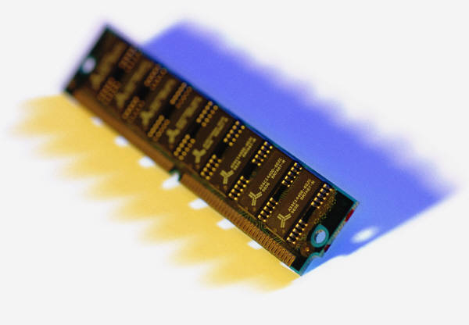
Static RAM (SRAM)
SRAM does not use capacitors.
SRAM uses several transistors in a cross-coupled flip-flop configuration and does not have the leakage issue and does not need to be refreshed. device that uses the same logic elements used in the processor
Will hold its data as long as power is supplied to it
Notes:
In contrast, a static RAM (SRAM) is a digital device that uses the
same logic elements used in the processor. In a SRAM, binary values are stored
using traditional flip-flop logic-gate configurations (see Chapter 11 for a description
of flip-flops). A static RAM will hold its data as long as power is supplied to it.
As in the DRAM, the SRAM address line is used to open or close a switch.
The address line controls two transistors (T₅ and T₆ ). When a signal is applied to
this line, the two transistors are switched on, allowing a read or write operation. For
a write operation, the desired bit value is applied to line B, while its complement
is applied to line B. This forces the four transistors (T₁ , T₂ , T₃ , T₄ ) into the proper
state. For a read operation, the bit value is read from line B.

Slide 49
DRAM vs SRAM
But SRAM still needs constant power to maintain the state of charge and thus is volatile like DRAM.
Since SRAM uses several transistors per bit of memory versus DRAM, which uses one transistor and capacitor per bit, DRAM is less expensive.
DRAM is at least ten times slower than SRAM. SRAM is faster and typically used for cache, DRAM is less expensive and has a higher density and has a primary use as main processor memory.

Slide 50
SRAM versus DRAM
SRAM
Both volatile
Power must be continuously supplied to the memory to preserve the bit values
Dynamic cell
Simpler to build, smaller
More dense (smaller cells = more cells per unit area)
Less expensive
Requires the supporting refresh circuitry
Tend to be favored for large memory requirements
Used for main memory
Static
Faster
Used for cache memory (both on and off chip)
DRAM
Notes:
Both static and dynamic RAMs are volatile; that is,
power must be continuously supplied to the memory to preserve the bit values.
A dynamic memory cell is simpler and smaller than a static memory cell. Thus, a
DRAM is more dense (smaller cells = more cells per unit area) and less expensive
than a corresponding SRAM. On the other hand, a DRAM requires the supporting
refresh circuitry. For larger memories, the fixed cost of the refresh circuitry is more
than compensated for by the smaller variable cost of DRAM cells. Thus, DRAMs
tend to be favored for large memory requirements. A final point is that SRAMs are
somewhat faster than DRAMs. Because of these relative characteristics, SRAM is
used for cache memory (both on and off chip), and DRAM is used for main memory.

Slide 51
Read Only Memory (ROM)
Contains a permanent pattern of data that cannot be changed or added to
No power source is required to maintain the bit values in memory
Data or program is permanently in main memory and never needs to be loaded from a secondary storage device
Data is actually wired into the chip as part of the fabrication process
Disadvantages of this:
No room for error, if one bit is wrong the whole batch of ROMs must be thrown out
Data insertion step includes a relatively large fixed cost
Notes:
As the name suggests, a read-only memory (ROM) contains a permanent pattern
of data that cannot be changed. A ROM is nonvolatile; that is, no power source is
required to maintain the bit values in memory. While it is possible to read a ROM,
it is not possible to write new data into it. An important application of ROMs is
microprogramming, discussed in Part Four. Other potential applications include
• Library subroutines for frequently wanted functions
• System programs
• Function tables
For a modest-sized requirement, the advantage of ROM is that the data or program
is permanently in main memory and need never be loaded from a secondary storage
device.
A ROM is created like any other integrated circuit chip, with the data actually
wired into the chip as part of the fabrication process. This presents two problems:
• The data insertion step includes a relatively large fixed cost, whether one or
thousands of copies of a particular ROM are fabricated.
• There is no room for error. If one bit is wrong, the whole batch of ROMs must
be thrown out.

Slide 52
Programmable ROM (PROM)
Less expensive alternative
Nonvolatile and may be written into only once
Writing process is performed electrically and may be performed by supplier or customer at a time later than the original chip fabrication
Special equipment is required for the writing process
Provides flexibility and convenience
Attractive for high volume production runs
Notes:
Creating ROM chips totally from scratch is time-consuming and very expensive in small quantities. For this reason, mainly, developers created a type of ROM known as programmable read-only memory (PROM). Blank PROM chips can be bought inexpensively and coded by anyone with a special tool called a programmer.

Slide 53
Erasable programmable read-only memory (EPROM)
EPROM chips can be rewritten many times.
Erasing an EPROM requires a special tool that emits a certain frequency of ultraviolet (UV) light.
EPROMs are configured using an EPROM programmer that provides voltage at specified levels depending on the type of EPROM used.
Note: To rewrite an EPROM, you must erase it first. (with UV light at a frequency of about 253.7 for standard EPROM)
Notes:
Working with ROMs and PROMs can be a wasteful business. Even though they are inexpensive per chip, the cost can add up over time. Erasable programmable read-only memory (EPROM) addresses this issue.
_______________
An EPROM eraser is not selective, it will erase the entire EPROM. The EPROM must be removed from the device it is in and placed under the UV light of the EPROM eraser for several minutes. An EPROM that is left under too long can become over-erased. In such a case, the EPROM's floating gates are charged to the point that they are unable to hold the electrons at all.

Slide 54
Electrically erasable programmable read-only memory (EEPROM)
The chip does not have to removed to be rewritten.
The entire chip does not have to be completely erased to change a specific portion of it.
Changing the contents does not require additional dedicated equipment.
Instead of using UV light, you can return the electrons in the cells of an EEPROM to normal with the localized application of an electric field to each cell. This erases the targeted cells of the EEPROM, which can then be rewritten.
However, EEPROMs are changed 1 byte at a time, which makes them versatile but slow. In fact, EEPROM chips are too slow to use in many products that make quick changes to the data stored on the chip.
Notes:
Though EPROMs are a big step up from PROMs in terms of reusability, they still require dedicated equipment and a labor-intensive process to remove and reinstall them each time a change is necessary. Also, changes cannot be made incrementally to an EPROM; the whole chip must be erased. Electrically erasable programmable read-only memory (EEPROM) chips remove the biggest drawbacks of EPROMs.

Slide 55
Flash Memory
Flash memory, a type of EEPROM that uses in-circuit wiring to erase by applying an electrical field to the entire chip or to predetermined sections of the chip called blocks.
Much faster than traditional EEPROMs because it writes data in chunks, usually 512 bytes in size, instead of 1 byte at a time.
Used in solid state drives.
Notes:
Manufacturers responded to EEPROM limitation with Flash memory.

Slide 56
Read-Mostly Memory
EPROM
Erasable programmable read-only memory
Erasure process can be performed repeatedly
More expensive than PROM but it has the advantage of the multiple update capability
EEPROM
Electrically erasable programmable read-only memory
Can be written into at any time without erasing prior contents
Combines the advantage of non-volatility with the flexibility of being updatable in place
More expensive than EPROM
Flash Memory
Intermediate between EPROM and EEPROM in both cost and functionality
Uses an electrical erasing technology, does not provide byte-level erasure
Microchip is organized so that a section of memory cells are erased in a single action or “flash”
Notes:
Another variation on read-only memory is the read-mostly memory, which is
useful for applications in which read operations are far more frequent than write
operations but for which nonvolatile storage is required. There are three common
forms of read-mostly memory: EPROM, EEPROM, and flash memory.
The optically erasable programmable read-only memory (EPROM) is read
and written electrically, as with PROM. However, before a write operation, all the
storage cells must be erased to the same initial state by exposure of the packaged
chip to ultraviolet radiation. Erasure is performed by shining an intense ultraviolet
light through a window that is designed into the memory chip. This erasure process
can be performed repeatedly; each erasure can take as much as 20 minutes to
perform. Thus, the EPROM can be altered multiple times and, like the ROM and
PROM, holds its data virtually indefinitely. For comparable amounts of storage, the
EPROM is more expensive than PROM, but it has the advantage of the multiple
update capability.
A more attractive form of read-mostly memory is electrically erasable programmable
read-only memory (EEPROM). This is a read-mostly memory that can
be written into at any time without erasing prior contents; only the byte or bytes
addressed are updated. The write operation takes considerably longer than the read
operation, on the order of several hundred microseconds per byte. The EEPROM
combines the advantage of non-volatility with the flexibility of being updatable in
place, using ordinary bus control, address, and data lines. EEPROM is more expensive
than EPROM and also is less dense, supporting fewer bits per chip.
Another form of semiconductor memory is flash memory (so named because
of the speed with which it can be reprogrammed). First introduced in the mid-1980s,
flash memory is intermediate between EPROM and EEPROM in both cost and
functionality. Like EEPROM, flash memory uses an electrical erasing technology.
An entire flash memory can be erased in one or a few seconds, which is much faster
than EPROM. In addition, it is possible to erase just blocks of memory rather than
an entire chip. Flash memory gets its name because the microchip is organized so
that a section of memory cells are erased in a single action or “flash.” However,
flash memory does not provide byte-level erasure. Like EPROM, flash memory
uses only one transistor per bit, and so achieves the high density (compared with
EEPROM) of EPROM.

Slide 57
HDD vs SSD
HDD
SSD
Contains a circular disc – known as a platter – that stores your data. The disc spins, allowing the read-write arm to read data on the disc (or write data to it) as it passes.
The faster the platter spins, the faster the hard drive works, which can impact how quickly your operating system responds, and how long it takes applications installed on the drive to load and open.
No moving parts, quieter
Uses NAND flash memory
Takes up less space; even mounted directly on motherboard
SSD storage is much faster than its HDD equivalent
Notes:
If you have a desktop PC it will most likely have a traditional hard disk drive, on which the operating system, along with any applications you install, and your files and folders, are stored.
A traditional hard drive contains a circular disc – known as a platter – that stores your data. The disc spins, allowing the read-write arm to read data on the disc (or write data to it) as it passes.
_______________________
A big difference with the traditional hard disk is that an SSD does not contain moving parts. This makes them much faster, quieter. In addition, an SSD is much more energy-efficient than a regular hard drive. For laptops, this means a longer battery life.

Slide 58
Questions?
Notes:
https://www.youtube.com/watch?v=jFDMZpkUWCw

